Slide 1
LEVEL 01 PROJECT
Microcontroller Based Dual – Mode Clay Fabrication System
254037B – CHAMIDYA J.A.S (IT)
254048J – DE SILVA P.S.S (IT)
255078H – OMESH N.A.N (ITM)
254101R – KALANSOORIYA O.K (IT)
255027D – GOONATILLAKA W.A.D.S.S (ITM)
Arduino / ESP32
Stepper Motors
Clay Extrusion
Sensor Suite
Real-Time Control
Supervisor: Mr. B.H. Sudantha
Microcontroller-Based 3D Potter Printer · Automated Clay Printing System

Slide 2
Table of Contents
No. | Content
1 | Introduction
2 | Key Features
3 | Aim and Objective
4 | Problem and Proposed Solution
5 | Block Diagram
6 | Operational Flow
7 | Power System
8 | Hand Drawn Sketch Diagram
9 | Automated Material Preparation
10 | Sensor System and Purpose
11 | Components and Technologies used
12 | Expected Budget
No. | Content
13 | Work Distribution
14 | Project Process
15 | References
16 | Conclusion
Microcontroller-Based 3D Potter Printer | Contents

Slide 3
Introduction
This project designs and develops an automated 3D pottery printer capable of creating ceramic structures — cups, pots, vases, artistic models and prototypes — using microcontroller-based XYZ motion, clay extrusion, moisture monitoring, pattern drawing and shape accuracy.
🎯
Purpose
⚙️
Mechanism
Automate traditional pottery using precision engineering and microcontroller technology
3-axis stepper motor gantry + auger/piston clay extrusion with nozzle control and pattern drawing
📡
Sensing
🖥️
Interface
Moisture, load cell, ultrasonic, limit switches & DHT22 for environment monitoring
LCD display, keypad, SD card input, real-time status & safety shut-off system
Microcontroller-Based 3D Potter Printer | Introduction

Slide 4
Key Features
📐
3-Axis Motion Control (X, Y, Z)
🔩
Automated Pattern Drawing
🪣
Controlled Clay Extrusion (Auger)
💧
Moisture Sensor — Anti-Clog
🎚️
Automated Material Preparation
🌡️
Temperature & Humidity Monitor
🖥️
LCD Display + Keypad Interface
💾
SD Card / USB File Input
🛑
Emergency Safety Shut-Off
📊
Bust / Sculpture Creation
Microcontroller-Based 3D Potter Printer | Key Features

Slide 5
Aim & Objectives
AIM
OBJECTIVES
To design and develop a fully automated, microcontroller-based 3D pottery printer that can fabricate ceramic objects from digital designs — replacing manual pottery techniques with precise, repeatable, sensor-guided clay extrusion and pattern drawing.
1
Design a 3-axis (X, Y, Z) stepper motor gantry system with auto-bed leveling for accurate layer-by-layer clay deposition and automated pattern designing.
2
Develop a clay extrusion mechanism using an auger/piston system with moisture-sensor feedback to prevent nozzle clogging.
3
Program a microcontroller (Arduino Mega / ESP32) to interpret G-code, control motion, and manage sensor-driven adjustments.
Automate
Precision
Reproduce
4
Integrate a sensor suite (moisture, load cell, ultrasonic, DHT22, limit switches) for automated material identification.
5
Implement a user interface with LCD display, keypad, and SD card input, including a safety emergency-stop system.
Microcontroller-Based 3D Potter Printer | Aim & Objectives

Slide 6
Problem and Proposed Solution
PROBLEM
SOLUTION
1
Hand-thrown pottery demands years of skill — wall thickness, shape and repeatability are hard for beginners, small studios and educators to achieve consistently.
1
One ESP32-based 3-axis (X, Y, Z) gantry prints both pottery vessels and sculptural forms from a digital G-code file — no separate machines needed.
2
Existing commercial clay 3D printers (e.g. WASP, Delta WASP) are single-purpose, expensive, and require manually pre-mixed clay to be loaded by hand.
2
Automated material preparation (mixing + moisture sensing) removes manual clay loading and pre-mixing entirely.
3
Hobbyists, small studios and ceramics/STEAM education programs have no affordable, versatile machine that covers both pottery and sculptural work.
3
Built for ~Rs. 87,000 – 95,000 — a fraction of the cost of single-purpose commercial clay printers.
4
------
4
----
5
-----
5
-----
Microcontroller-Based 3D Potter Printer | Problem and Proposed Solution

Slide 7
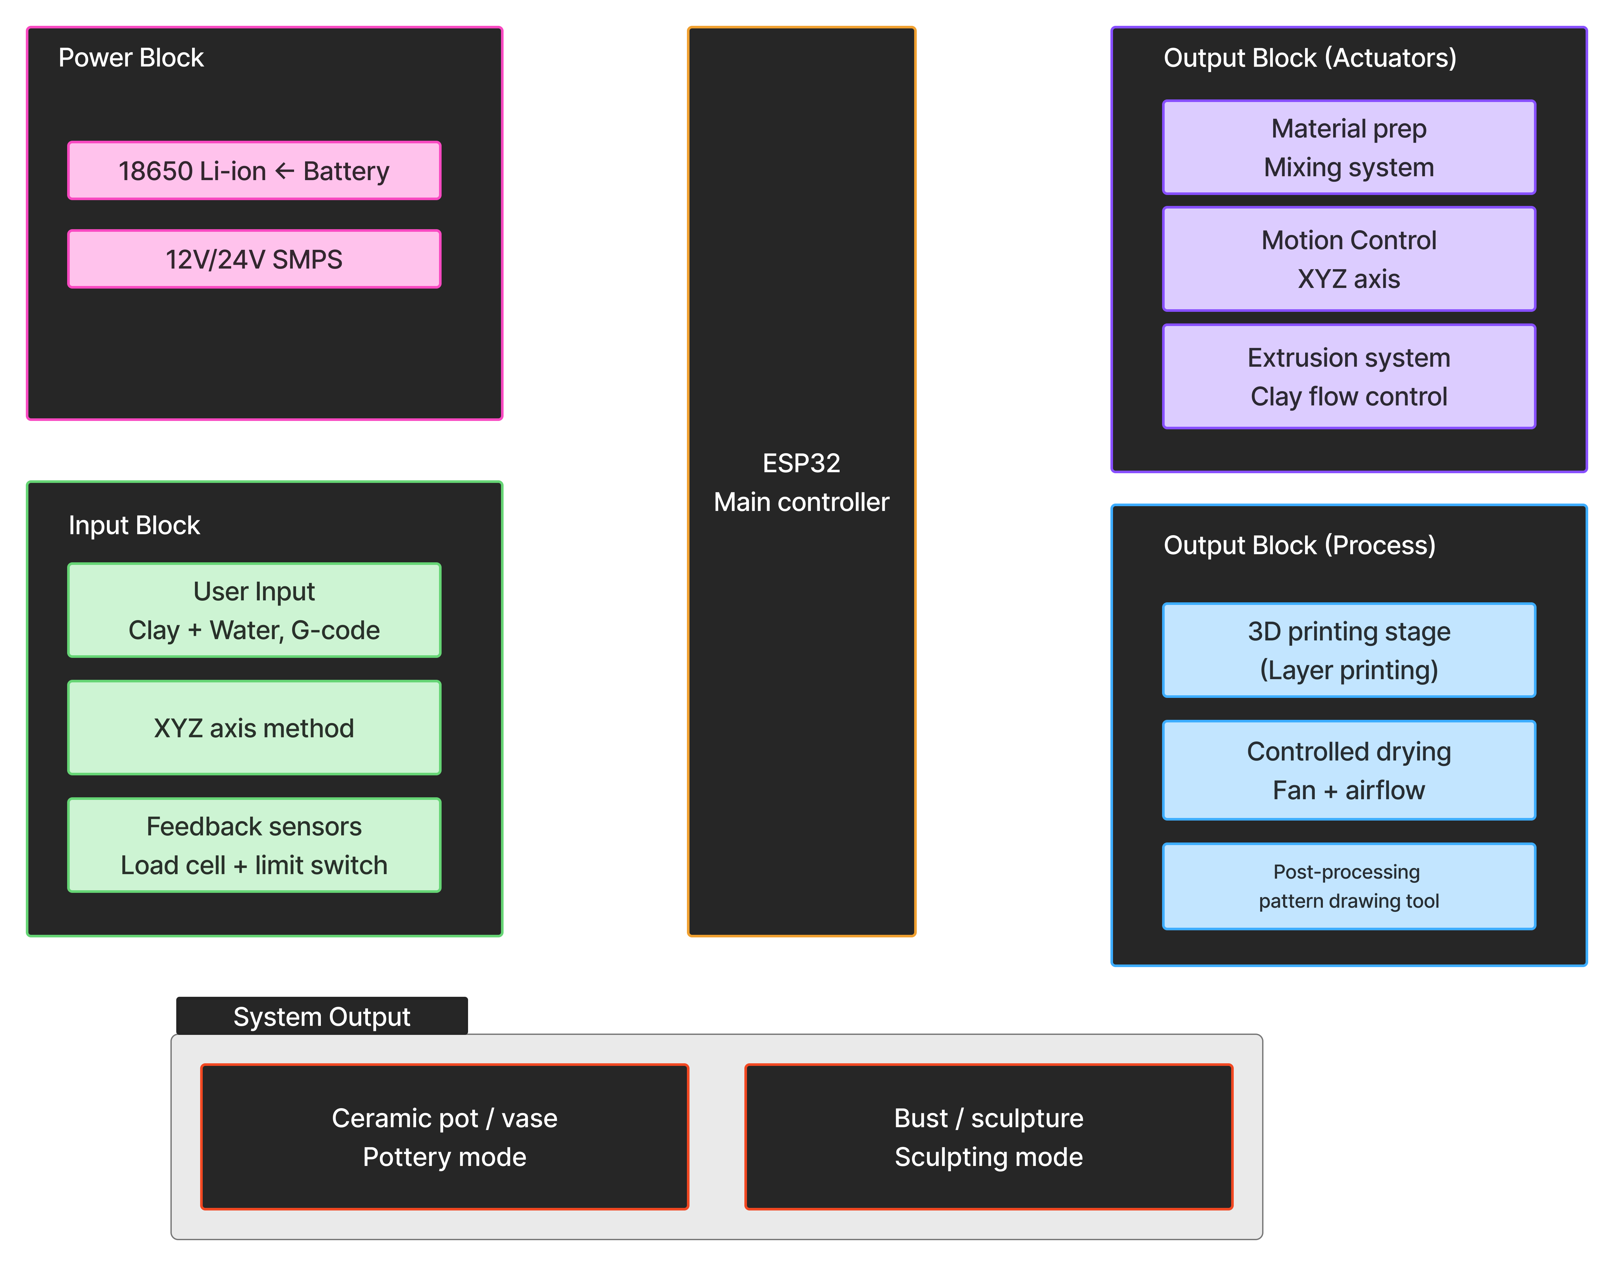
System Block Diagram
Microcontroller-Based 3D Potter Printer | System Block Diagram

Slide 8
Operational Flow
System Start & Initialization
5. Mode Based Printing
9. Print Completion
▸ Power ON → MCU boots
▸ X, Y, Z axes motion for bust/sculpture
▸ Extrusion stops
▸ Self-check: Motors, Sensors, Modules
▸ Rotary Mode for pot/vase
▸ Nozzle lifts away from object
▸ Display: System Ready – Load Material
▸ Display: Printing Completed
6. Design Input
2. Material Loading
▸ User inserts SD card / selects file
10. Controlled Drying Phase
▸ User loads clay (earthenware, semi-dry)
▸ System reads G-code
▸ User adds initial water
▸ Display: File Loaded: Vase.gcode
▸ Controlled airflow (not just a fan)
▸ No manual mixing required
▸ Optional temperature monitoring
7. Pre-Print Setup
▸ Slow air circulation for uniform moisture removal
3. Automated Material Prep3.
▸ Result: stable object, minimized crack risk
▸ Nozzle height calibration
▸ Mixer motor rotates: clay + water combine
▸ Extrusion pressure check
11. Post-Processing (After Firing)
▸ Load cell + HX711 measures extrusion resistance
▸ Bed positioning confirmed
▸ Motor current monitors torque behavior
▸ User fires pot externally, then re-loads
▸ Auto loop: Mix → Test → Adjust → Repeat
8. 3D Printing Process
▸ Tool switch: extruder → drawing tool
▸ Too thick? → Add water | Too soft? → Continue mix
▸ User selects design file
▸ Target range met → Material Ready
▸ Extruder begins clay flow → nozzle to start point
▸ Machine draws: patterns, text, decorative designs
▸ X-Y movement forms shape layer by layer for sculpting
4. Material Transfer to Extruder
▸ Rotating bed for smooth pottery
12. Final Output
▸ Prepared clay flows to extrusion chamber
▸ Real-time: monitor extrusion pressure, flow, motor load
▸ Pressure stabilized before print start
▸ Error? → Pause print, show warning, wait for fix
▸ Fully formed ceramic object
▸ Decorated surface with patterns/text
▸ Fully formed bust / sculpture
Microcontroller-Based 3D Potter Printer | Operational Flow

Slide 9
Power System (Switch Mode Power Supply)
✅ Normal (AC ON)
⚠️ Power Failure
🔋 AC Restored
AC → SMPS → Powers system
Battery charges simultaneously
SMPS stops → Battery instantly
supplies power. No interruption.
Switches back to SMPS
Battery resumes charging
AC Mains
230V Input
Main Power Supply
▸ 24V, 10A SMPS (≈240W)
▸ Sufficient for all motors & electronics
Charger
Charges when AC on
Battery Pack
SMPS
230V -> 24V DC
▸ 24V Lithium-ion
▸ 10Ah minimum | 20Ah maximum
Battery Charger Module
DC Bus
24V Distribution
24V Battery
10-20Ah Pack
▸ Charges when AC power is available
▸ Keeps battery at full capacity
Auto Switching Circuit
▸ Option B: Relay / Transfer Module (better)
Motors
Mix X, Y, Z
MCU & Sensors
ESP32 + Modules
Auto Switch
Relay
DC-DC Converter
▸ Steps 24V → 5V for MCU & sensors
▸ Regulated, stable low-voltage supply
🔋 Backup Runtime Estimate
Energy = 24V × 10Ah = 240Wh | Runtime ≈ 240 ÷ 150W ≈ 1.5 hours
Sufficient for emergency save or safe shutdown of in-progress print
Microcontroller-Based 3D Potter Printer | Power System

Slide 10
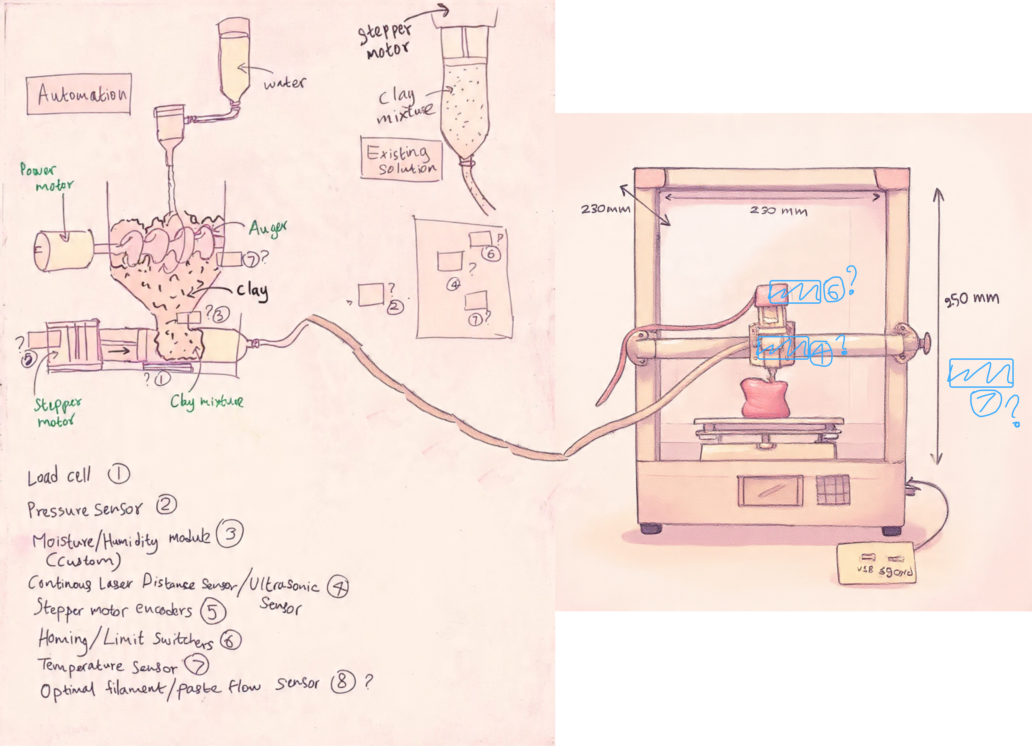
Hand Sketch Design
Microcontroller-Based 3D Potter Printer | Hand Sketch Design

Slide 11
Automated Material Preparation
The module creates the printing material to the printer by an automated process — no human intervene required.
1
Raw Materials Input
2
Mixing Chamber Activation
3
Moisture Detection
User puts water and clay into the mixing chamber
Mixing process begin inside a sealed chamber by a motor driven mixer
Checks the water level and if the mixture dry, pump some water
4
Thickness Check
5
Closed Loop
6
Decision
Extruder motor pushes and measure resistant and if dry, add water and mix
Mix → Measure → Adjust → Repeat
Print OK / Adjust settings / Reject material
Microcontroller-Based 3D Potter Printer | Material Identification

Slide 12
Sensor System & Purpose
💧
Moisture Sensor
Detects clay water content (25–35%). Prevents nozzle clogging & auto-adjusts extrusion speed.
🔘
Limit Switches ×3
Detects home position for X, Y and Z axes. Essential for accurate homing and auto-bed leveling.
⚖️
Load Cell
Measures extrusion pressure. Identifies clay that is too thick or too runny in real-time.
📡
Ultrasonic Sensor
Monitors nozzle standoff height above the clay surface for consistent layer thickness.
🌡️
DHT22 Sensor
Monitors environment temp & humidity. Ensures optimal clay drying rate during printing.
Microcontroller-Based 3D Potter Printer | Sensor System

Slide 13
Hardware Components
Category | Components
Power System | 230V AC Input
 | 24V Battery Pack
 | Battery charger (24V compatible)
 | 5V DC-DC buck converter (for logic & sensors)
Control & Electronics | ESP32 DevKit V1
 | Stepper drivers: TMC2208 or A4988 (×4–5)
 | 20×4 LCD or TFT display
 | Rotary encoder / keypad
 | SD card module (for G-code)
 | Wiring (silicone wires, connectors, ferrules)
Motion System | NEMA 17 stepper motors ×3 (X, Y, Z)
 | Timing belts (GT2) + pulleys (X, Y)
 | Aluminium profile frame (2020 / 2040)
 | Limit switches ×3 (X, Y, Z homing)
Material Preparation System | Mixing chamber (metal cylinder)
 | Mixing shaft with auger
 | High-torque DC gear motor (for mixing)
Category | Components
 | Motor driver (H-bridge or PWM controller)
 | Mini water pump (12V/24V)
Smart Consistency Detection | Load cell (5–20 kg) + HX711
 | Motor current sensor (INA219)
Extrusion System | Extruder barrel (metal)
 | NEMA 17 stepper motor (extruder)
 | Stepper drivers: TMC2208 or A4988 (×4–5)
 | Nozzle set (interchangeable diameters 1–3 mm)
Controlled Drying System | DC fan(s) (12V/24V)
 | Simple vent control (manual flaps)
Pattern Drawing Unit | Pen/paint marker holder
 | Small servo (optional Z-pressure control)
Safety & Reliability | Emergency stop button
 | Overcurrent fuse (battery + SMPS output)
 | Proper enclosure/guards for moving parts
Microcontroller-Based 3D Potter Printer | Hardware Components

Slide 14
Estimated Budget (LKR)
Frame (Aluminium Profiles)
Rs. 18,000
Stepper Motors × 4
Rs. 16,000
ESP32
Rs. 5,500
Stepper Drivers
Rs. 5,000
Sensors (All)
Rs. 3,500
Display + Keypad
Rs. 4,000
Clay Extrusion System
Rs. 12,000
Power Supply
Rs. 6,000
Wiring + PCB
Rs. 7,000
Miscellaneous
Rs. 10,000
TOTAL
Rs. 87,000 – 95,000
Microcontroller-Based 3D Potter Printer | Budget

Slide 15
Team Member Work Breakdown
DE SILVA P.S.S
OMESH N.A.N
GOONATILLAKA W.A.D.S.S
CHAMIDYA J.A.S
KALANSOORIYA O.K
1
2
3
4
5
Control System & Coordination Lead
🔧 Hardware Module:
Microcontroller system (ESP32 / Arduino Mega 2560)
Power distribution & wiring
📡 Sensor Responsibility:
Temperature & humidity sensor (DHT22)
Material Preparation
🔧 Hardware Module:
Mixing chamber
Mixing motor + shaft design
Water pump system
📡 Sensor Responsibility:
Moisture sensor
Extrusion System Lead
🔧 Hardware Module:
Auger / piston extrusion system
Nozzle design
Clay flow mechanism
📡 Sensor Responsibility:
Load cell + HX711
Motion System Lead
🔧 Hardware Module:
X, Y, Z axis mechanics
Stepper motors + rails + belts
Frame assembly
📡 Sensor Responsibility:
Limit switches (X, Y, Z homing)
User Interface & System Monitoring Lead
🔧 Hardware Module:
LCD / TFT display
Keypad / rotary encoder
SD card module
📡 Sensor Responsibility:
Motor current sensing
Microcontroller-Based 3D Potter Printer | Team Breakdown

Slide 16
Project Process — 10 Months
01
02
03
04
05
Research & Requirements
System Design
Component Procurement
Mechanical Construction
Electronics Assembly
06
07
08
09
10
Software Development
System Integration
Calibration & Testing
Performance Optimization
Documentation & Report
Microcontroller-Based 3D Potter Printer | Project Process

Slide 17
References
01 Espressif Systems — ESP32 Datasheet
05 RepRap Project — G-code Reference
ESP32 Series Datasheet v5.2 · documentation.espressif.com
G-code Command Wiki · reprap.org/wiki/G-code
02 Analog Devices — TMC2208 Driver Datasheet
06 Ruscitti, Tapia & Rendtorff (2020)
TMC220X/TMC2224 Datasheet Rev. 1.14 · analog.com
AM of Ceramics via Clay-Paste Extrusion, Cerâmica 66(380)
03 Avia Semiconductor — HX711 ADC Datasheet
07 Cárdenas Correa, Torres Barahona & Carda Castelló (2026)
24-Bit ADC for Weigh Scales · cdn.sparkfun.com
Ceramic AM via Direct Ink Writing: A Review, Ceramics 9(2):16
04 Aosong Electronics — AM2302/DHT22 Manual
Digital Humidity & Temperature Sensor · aosong.com
Microcontroller-Based 3D Potter Printer | References

Slide 18
CONCLUSION
A Smart Solution for Modern Pottery
Fully automated clay printing — microcontroller replaces manual pottery skill
Precise 3-axis stepper motor control with sensor-driven auto-bed leveling
Intelligent material identification through an integrated 5-sensor suite
Safe and user-friendly: LCD interface, emergency stop, real-time monitoring
Budget-conscious design: approx. Rs. 87,000 – 95,000 total cost
Thank You · Microcontroller-Based 3D Potter Printer · Level 01 Project

